Slide 1
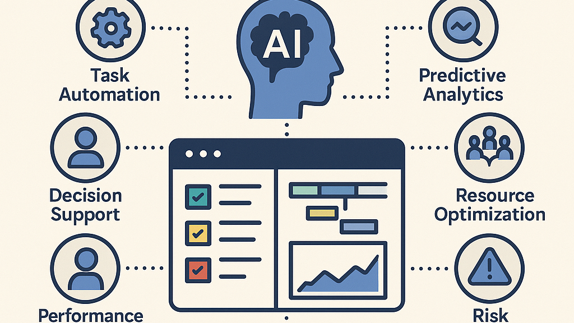
Title: AI-Powered Employee Emotion Analysis and Task Recommendation System
Done by-
Yurekan M

Slide 2
INTRODUCTION
Employee productivity is closely linked to emotional well-being
Emotional stress often goes unnoticed in organizations
Manual monitoring is difficult and subjective
AI can help analyze employee emotions using textual feedback
PROBLEM STATEMENT
Lack of real-time insight into employee emotions
Stress and burnout reduce productivity
HR reacts only after performance drops
Need for an automated, data-driven solution

Slide 3
OBJECTIVES
Detect employee emotions from text feedback
Recommend suitable tasks based on emotions
Support employee well-being
Assist HR with actionable insights
DATASET DESCRIPTION
Synthetic employee feedback dataset
Ensures privacy and ethical usage
Emotion labels:
Happy
Neutral
Stressed
Bored
Anxious
Used for supervised machine learning

Slide 4
SYSTEM ARCHITECTURE
Employee Feedback
↓
Text Preprocessing
↓
Emotion Detection (ML)
↓
Task Recommendation
↓
HR Insights & Analytics

Slide 5
METHODOLOGY
Text preprocessing (cleaning, stopword removal)
Feature extraction using TF-IDF
Emotion classification using Logistic Regression
Rule-based task recommendation
Batch processing and analysis
MODEL & TOOLS USED
Machine Learning Model: Logistic Regression
NLP Technique: TF-IDF
Programming Language: Python
Libraries:
Pandas
Scikit-learn
NLTK
Matplotlib
Seaborn

Slide 6
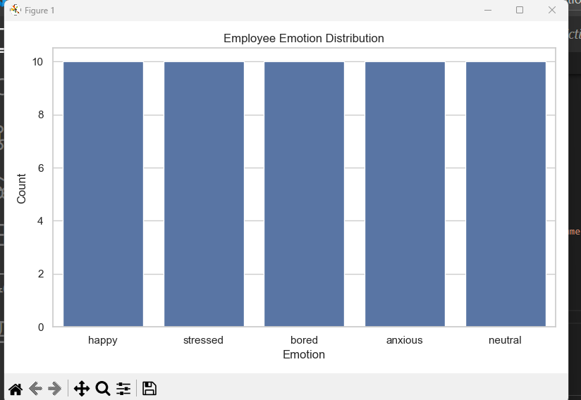
RESULTS-EMOTION ANALYSIS
Emotion Distribution Graph
Shows overall emotional state of employees
Helps identify dominant emotions such as stress or happiness

Slide 7
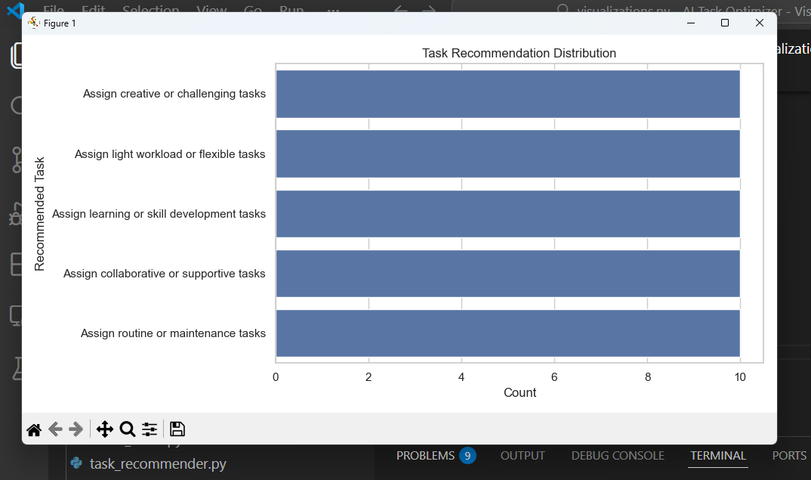
RESULTS – TASK RECOMMENDATION
Task Recommendation Distribution Graph
Illustrates how tasks are assigned based on emotions
Ensures balanced workload and productivity

Slide 8
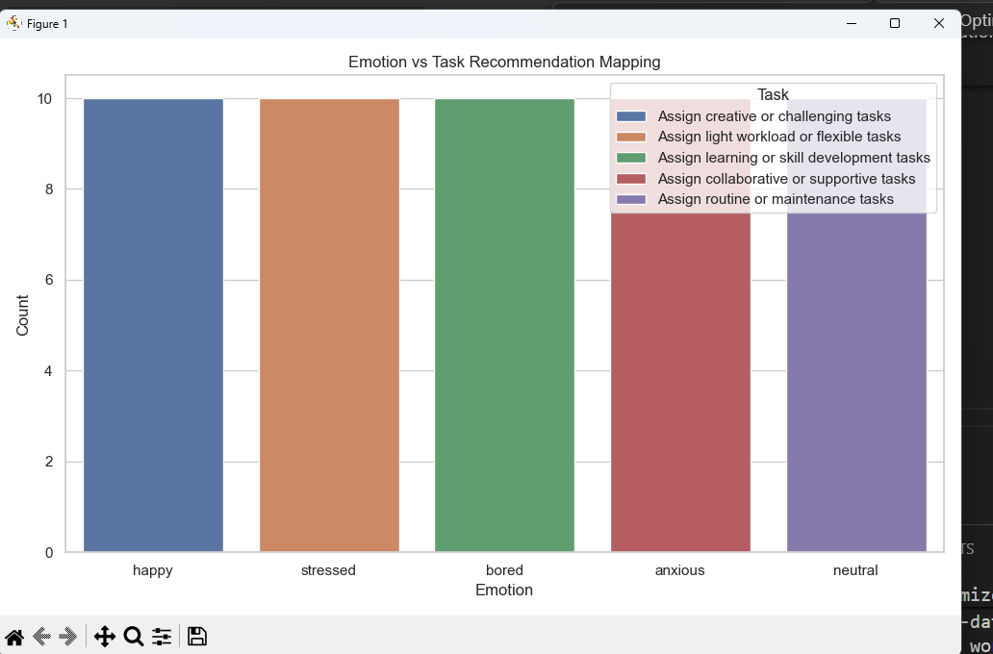
RESULTS – EMOTION vs TASK MAPPING
Emotion vs Task Mapping Graph
Demonstrates clear relationship between emotion and task type
Ensures explainable and transparent recommendations

Slide 9
BENEFITS & USE CASES
Improves employee well-being
Helps HR detect stress early
Data-driven task allocation
Reduces burnout and attrition
FUTURE SCOPE
Web application deployment
Real-time feedback analysis
Integration with HR systems
Advanced emotion detection models
CONCLUSION
Successfully developed an AI-based emotion analysis system
Demonstrated practical application of data science
System is scalable and ethically designed
Useful for modern workplace analytics

Slide 10
THANK YOU

